Slide 1

RC Quick Byte: uv Package Manager

Slide 2


uv Package Manager -- Get Your Sunscreen!
Date: October 1, 2025
Instructor: Mohal Khandelwal
Website: www.rc.colorado.edu/rc
Documentation: https://curc.readthedocs.io
Helpdesk: rc-help@colorado.edu
Survey: http://tinyurl.com/curc-survey18
Slides
https://github.com/ResearchComputing/uv_package_manager_quick_byte

Slide 3
What You’ll Learn
Introduction to uv
Key features of uv
Comparative analysis of uv with other tools
Using uv on CURC

Slide 4

What is uv?
Fast, modern Python package manager and environment builder.
Built by Astral (same team behind Ruff).
Implemented in Rust.
All-in-one solution
Designed to work natively with Python's built-in venv
Image source: https://docs.astral.sh/uv/

Slide 5
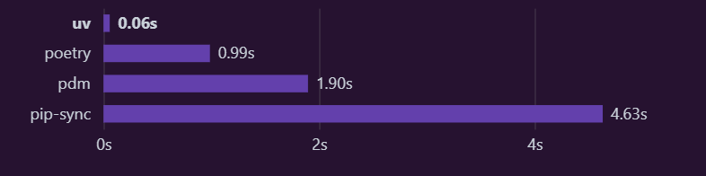
Features of uv
Drop-in Replacement for pip, pip-tools.
10-100x faster than traditional tools.
Reliable and reproducible builds
Memory-efficient operation, especially for large projects
Image source: https://docs.astral.sh/uv/

Slide 6
uv vs. the status quo
Feature | uv | Traditional pip + venv | conda
Speed | 10-100x faster than pip | Baseline | Slower than pip
Memory Usage | Very efficient | Higher | High
Reproducibility | Universal lockfile (uv sync). | Requires a separate tool (pip-tools) for locking. | YAML files (often flaky).
Non-Python Packages | No | No | Yes
Dependency Resolution | Fast, modern resolver | Basic | Comprehensive
Ease of use | Simple, single tool | Broader scope with a steeper learning curve. | Requires multiple commands (python -m venv, source, pip).

Slide 7
Getting Started with uv
To start using uv, you must first load the module in your interactive session:
$ module spider uv
$ module load uv
$ uv --version

Slide 8
Creating a uv Environment
uv automates the creation and management of environments using venv
venv is Python’s built-in tool for creating isolated environments
Each venv:
Has its own Python interpreter
Has its own installed packages, separate from system Python
Avoids dependency conflicts across projects
It's a lightweight alternative to Conda environments
Notes:
Utilizes a global cache for dependency deduplication, saving storage.

Slide 9
Creating a uv Environment
Loading the module sets a key environment variable $UV_ENVS.
To create a new environment
$ echo $UV_ENVS
/projects/$USER/software/uv/envs
$ uv venv $UV_ENVS/myenv
$ uv venv $UV_ENVS/myenv1 --python 3.8

Slide 10
Activating the Environment
Packages are installed within activated environments
Fully compatible with PyPI
Uses caching to speed up repeated installs
$ source $UV_ENVS/myenv/bin/activate
$ uv pip install numpy
$ uv pip install pandas

Slide 11
Useful Commands
uv <command> --help # help for specific commands
uv venv $UV_ENVS/<envname> # create a new environment
uv pip install <packagename> # install a package in active env
uv pip uninstall <packagename> # uninstall a package from env
rm –rf $UV_ENVS/<envname> # remove an environment
uv cache clean # clean up unused cache
uv pip freeze # list installed packages
deactivate # deactivate environment
Note: Be very careful with rm -rf when removing environments

Slide 12

Any Questions

Slide 13

Thank you!
http://tinyurl.com/curc-survey18
Survey and feedback
10/1/2025

